Slide 1
The Streaming Balance:
Unveiling Economic Trends, OTT platforms and Mental Health Insights
Team Members
Ritika Nigam (633002197)
Sushmita Pattanaik (433003793)

Slide 2

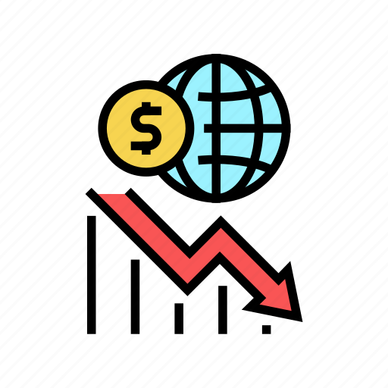


Motivation
The COVID-19 pandemic has significantly transformed society, impacting not only our health but also various socio-economic aspects.
It has led to changes in economic patterns, raised challenges in mental health, and brought about shifts in how we entertain ourselves.

Slide 3

Goals
The primary goal of this project is to:
Explore data trends across various socio-economic factors like:
1. Economy: GDP, Unemployment, Inflation etc
2. Mental Health: Happiness Index, Depression Rate
3. Over-the-top (OTT) platforms.
Intended Audience : Mental health advocates, therapists, psychologists, researchers, economists, financial analysts, professionals within the entertainment industry, and the general public.
Single Interactive session

Slide 4




Software/Tools Used
React
Tableau
CSS/Bootstrap
Github
Microsoft Excel
Python

Slide 5

Some of the Data Sources
Bureau of Economic Analysis (BEA)
U.S. Bureau of Labor Statistics (BLS)
Substance Abuse and Mental Health Services Administration (SAMHSA)
The Global Economy.com
Statista
CNBC

